Slide 1

Logging, Checkpointing and Crash Recovery
Database Management System | Transaction Management and Scheduling
Course: Database Management System | Chapter: Transaction Management and Scheduling | Program: B.TECH-CSE, B.TECH CSE - CYBER SECURITY, B.TECH CSE - DATA
DISCOVER · LEARN · EMPOWER
Notes:
Welcome everyone to this advanced session on crash recovery. We are diving deep into how databases survive power failures and disk crashes. Today we focus specifically on the mechanisms that ensure data integrity after a disaster. Remember, without these mechanisms, our database would be unreliable.

Slide 2
Course Outcomes
SLIDE 2 / 14
Course Outcome
CO | BT LEVEL | DESCRIPTION
CO1 | BT2 | Explain database architecture, relational model concepts and formal query language foundations including relational algebra and relational calculus.
CO2 | BT3 | Apply relational algebra, relational calculus and SQL constructs to formulate correct and efficient database queries.
CO3 | BT4 | Analyze functional dependencies and design normalized relational schemas up to 5NF ensuring lossless join and dependency preservation.
CO4 | BT4 | Analyze transaction schedules and concurrency control mechanisms to determine serializability, recoverability and correctness.
CO5 | BT5 | Evaluate storage structures, indexing strategies and query optimization techniques for performance, scalability and reliability.
Chandigarh University
2 / 14
Notes:
This lecture directly addresses our Course Outcomes. CO1 is covered as we explain the architectural necessity of logging for data consistency. CO5 is addressed because recovery mechanisms are critical for the reliability and scalability of our storage systems. We will evaluate how these techniques optimize performance during recovery.

Slide 3
Learning Objectives
SLIDE 3 / 14
Learning Outcomes
1
Analyze the role of the Log Buffer in ensuring atomicity during transactions.
2
Evaluate the trade-offs between frequent and infrequent checkpointing strategies.
3
Construct a recovery algorithm using the ARIES protocol principles.
4
Differentiate between Redo and Undo operations in crash scenarios.
5
Synthesize a recovery plan for a system failure occurring mid-transaction.
Chandigarh University
3 / 14
Notes:
By the end of this session, you will be able to analyze how the log buffer acts as a safety net. You will evaluate why we cannot checkpoint too often without hurting performance. We will construct recovery plans that handle both committed and uncommitted transactions correctly.

Slide 4
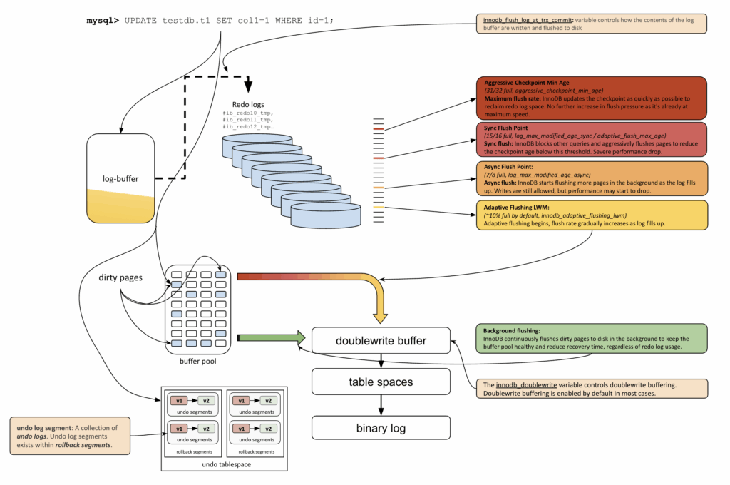
Lecture
SLIDE 4 / 14
The Role of the Write-Ahead Log
1
The WAL protocol mandates writing log records before data pages reach disk.
2
Log records contain the old value (before image) and new value (after image).
3
A log record is written to stable storage before the corresponding data update.
4
This ensures that no committed transaction data is lost during a crash.
5
The log acts as the single source of truth for recovery operations.
6
Without WAL, a crash could leave the database in an inconsistent state.
7
The log buffer is flushed to disk periodically to ensure durability.
MySQL with Diagrams Part Three: The Life Story of the Writing Process - Percona
Chandigarh University
4 / 14
Notes:
Think of the Write-Ahead Log as a flight recorder on an airplane. If the plane crashes, the log tells us exactly what happened. The rule is simple: write the log entry before you write the actual data page to the disk. This guarantees that if a crash happens, we can always reconstruct the state of the database.

Slide 5
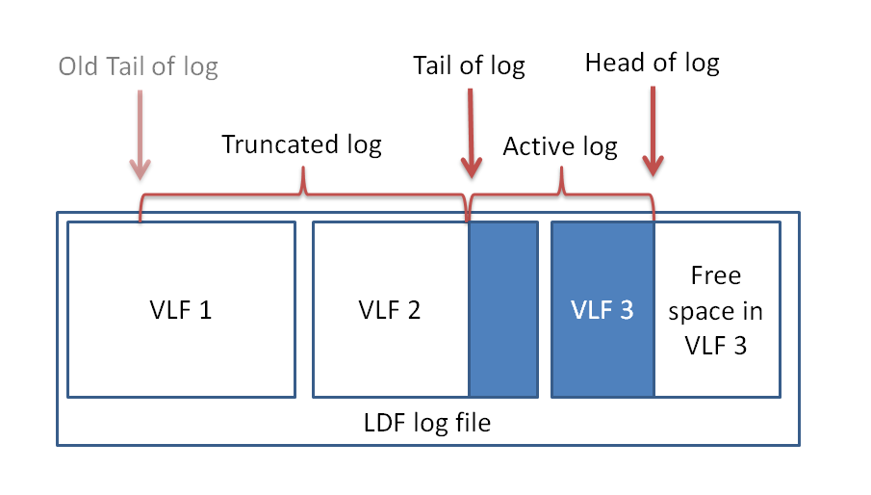
Lecture
SLIDE 5 / 14
Log Record Structure and Fields
1
Each log record includes a Transaction ID (TID) identifying the source.
2
The record contains a Log Sequence Number (LSN) for ordering operations.
3
The 'prevLSN' field links records to form a chain for each transaction.
4
The 'type' field specifies if the record is a START, UPDATE, or COMMIT.
5
The 'offset' field points to the specific data page being modified.
6
The 'beforeImage' stores the data value before the transaction changed it.
7
The 'afterImage' stores the new data value after the transaction changes it.
Source: rusanu.com
Chandigarh University
5 / 14
Notes:
Let's look at the anatomy of a log record. It has a unique ID, a sequence number, and links to the previous record. Crucially, it holds both the old and new values. This allows us to undo a change if needed or redo it if the system crashed before the update was written to disk.

Slide 6
Lecture
SLIDE 6 / 14
The Problem of Unbounded Log Growth
1
Continuous logging causes the log file to grow indefinitely over time.
2
An unbounded log consumes excessive disk space and degrades performance.
3
Recovery time increases linearly with the size of the log file.
4
We need a mechanism to truncate the log after processing completed transactions.
5
Checkpointing is the standard technique to manage log file size effectively.
6
Without checkpoints, the system cannot reclaim space from old log records.
7
The log must be truncated only after ensuring all data is on disk.
Chandigarh University
6 / 14
Notes:
Imagine a log file that never stops growing. Eventually, it fills up the disk, and recovery takes hours instead of minutes. We need a way to say, 'We have processed this far, we can delete the old logs.' This is where checkpointing comes in to reset the log and manage space efficiently.

Slide 7
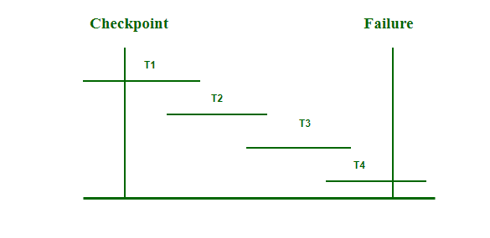
Checkpointing
SLIDE 7 / 14
Definition and Purpose
1
A checkpoint is a synchronization point where all active transactions are recorded.
2
It forces all dirty pages (modified data) to be written to stable storage.
3
The checkpoint record includes a list of all active transactions at that moment.
4
It allows the recovery system to ignore log records older than the checkpoint.
5
Checkpointing reduces the amount of log scanning required during recovery.
6
It effectively splits the log into a 'pre-checkpoint' and 'post-checkpoint' section.
7
The system state is consistent at the exact moment the checkpoint completes.
Source: media.geeksforgeeks.org
Chandigarh University
7 / 14
Notes:
A checkpoint is like a save point in a video game. It forces the system to write everything currently in memory to the disk. It also records which transactions were running at that exact moment. This allows us to skip scanning the entire log history during a crash recovery.

Slide 8
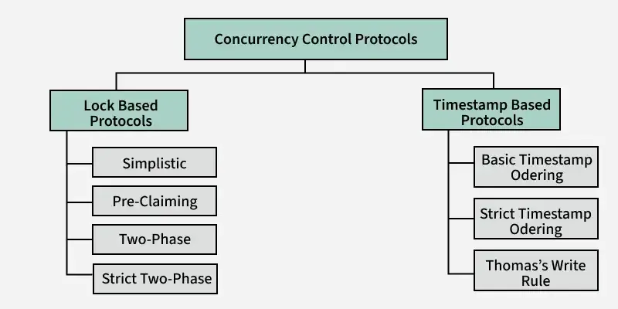
Lecture
SLIDE 8 / 14
Types of Checkpointing Strategies
1
Fuzzy Checkpointing allows transactions to continue while the checkpoint is taken.
2
Fuzzy checkpoints record the state of the database without stopping execution.
3
Coordinated Checkpointing requires all transactions to pause during the checkpoint.
4
Coordinated checkpoints are simpler but cause significant performance degradation.
5
Fuzzy checkpoints are preferred in high-performance production database systems.
6
The fuzzy approach requires careful handling of the log to ensure consistency.
7
The choice depends on the trade-off between recovery time and throughput.
Source: media.geeksforgeeks.org
Chandigarh University
8 / 14
Notes:
There are two main ways to do this. Coordinated checkpointing stops everything, which is slow. Fuzzy checkpointing lets transactions keep running while we record the state. We prefer fuzzy checkpoints because they minimize the impact on system performance, though they require more complex logic to handle.

Slide 9
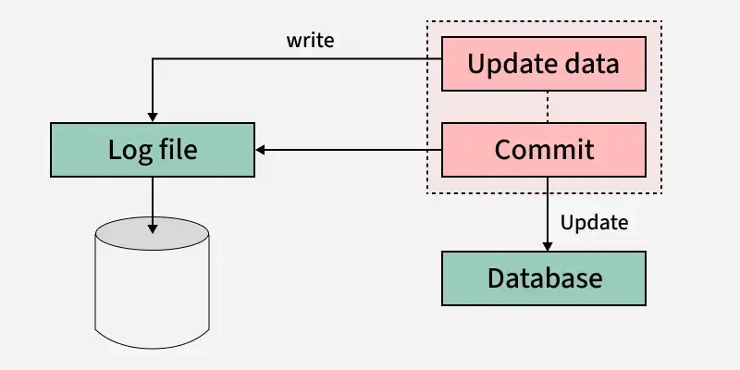
Crash Recovery
SLIDE 9 / 14
The Recovery Manager
IT OPERATES IN TWO PHASES
Analysis and Recovery (Redo/Undo).
• The Recovery Manager is responsible for restoring the database after a crash.
• It uses the log to determine which transactions need to be redone.
• It identifies transactions that were active but not committed at the time of crash.
• These uncommitted transactions must be undone to maintain atomicity.
• The recovery process ensures the database returns to a consistent state.
• The process is automatic and transparent to the end-user applications.
Source: media.geeksforgeeks.org
Chandigarh University
9 / 14
Notes:
When the system restarts, the Recovery Manager takes charge. It scans the log to see what happened. It identifies transactions that were in progress when the crash occurred. These are the ones we must undo. It also checks for committed transactions that might not have been written to disk yet, which we must redo.

Slide 10
Lecture
SLIDE 10 / 14
Redo and Undo Operations Explained
1
Redo operation reapplies changes for committed transactions that were not written.
2
Undo operation reverses changes for uncommitted transactions that were partially applied.
3
Redo ensures durability of committed data despite disk failures.
4
Undo ensures atomicity by rolling back incomplete transactions.
5
The system uses the 'beforeImage' to perform the Undo operation.
6
The system uses the 'afterImage' to perform the Redo operation.
7
Both operations are applied sequentially to restore the database state.
Chandigarh University
10 / 14
Notes:
Redo is about making sure committed work is saved. If a transaction committed but the data didn't hit the disk, we redo it. Undo is about rolling back. If a transaction was halfway through when the power went out, we use the old values to reverse its changes. This keeps the database consistent.

Slide 11
Worked Example
SLIDE 11 / 14
Recovery Scenario
SCENARIO
T1 commits, T2 crashes before commit, T3 is active.
LOG SEQUENCE
START(T1), UPDATE(T1), COMMIT(T1), START(T2), UPDATE(T2), CRASH.
RECOVERY ANALYSIS
T1 is committed, T2 is uncommitted, T3 is active.
REDO PHASE
Reapply T1 updates to ensure they are on disk.
UNDO PHASE
Reverse T2 updates using the beforeImage values.
RESULT
T1 changes are permanent, T2 changes are removed.
FINAL STATE
Database reflects only the committed transaction T1.
Chandigarh University
11 / 14
Notes:
Let's look at a concrete example. Suppose T1 commits, then T2 starts and updates data, but then the system crashes. T2 is uncommitted. During recovery, we redo T1 to ensure its data is safe. Then we undo T2 because it never finished. The result is a clean database with only T1's changes.

Slide 12
Lecture
SLIDE 12 / 14
Common Pitfalls in Recovery Implementation
1
Failing to write the log record before the data page causes data loss.
2
Not flushing the log buffer to disk before a commit violates durability.
3
Incorrectly identifying active transactions leads to lost or partial data.
4
Skipping the checkpoint process results in excessively long recovery ×.
5
Ignoring the 'prevLSN' chain can break the transaction history linkage.
6
Assuming all data is on disk without checking dirty page lists.
7
Overlooking the need to restart uncommitted transactions after a crash.
Chandigarh University
12 / 14
Notes:
There are many ways to get this wrong. The most common pitfall is writing the data to disk before the log record. This violates the WAL protocol and can lead to permanent data loss. Another issue is not flushing the log buffer before declaring a transaction committed. This breaks the durability guarantee.

Slide 13
Lecture
SLIDE 13 / 14
Key Takeaways
1
Write-Ahead Logging ensures data integrity by logging before writing data.
2
Checkpointing manages log size and significantly reduces recovery time.
3
Redo operations restore committed data lost during a crash.
4
Undo operations reverse uncommitted changes to maintain atomicity.
5
The Recovery Manager orchestrates the entire process automatically.
Chandigarh University
13 / 14
Notes:
To summarize, the Write-Ahead Log is the foundation of recovery. Checkpoints are essential for performance. Redo and Undo are the two pillars of the recovery process. Together, they ensure that your database remains reliable even after a catastrophic failure.

Slide 14
Lecture
SLIDE 14 / 14
References
1
Fundamentals of Database Systems — Ramez Elmasri & Shamkant B. Navathe
2
Database System Concepts — Silberschatz, Korth & Sudarshan
3
Database Management Systems — Raghu Ramakrishnan & Johannes Gehrke
4
Oracle/MySQL Documentation — Oracle
Chandigarh University
14 / 14
Notes:
For further reading, I recommend the textbooks by Elmasri and Navathe, as well as Silberschatz. These resources provide deep insights into the theoretical and practical aspects of transaction management. The Oracle documentation is also excellent for understanding real-world implementation details.

